Slide 1
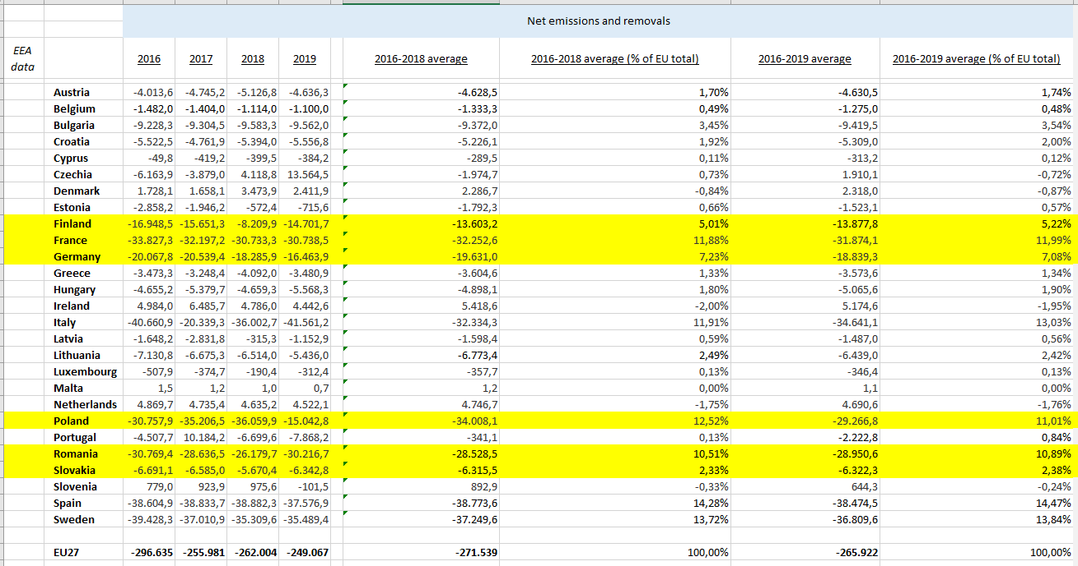

Slide 2
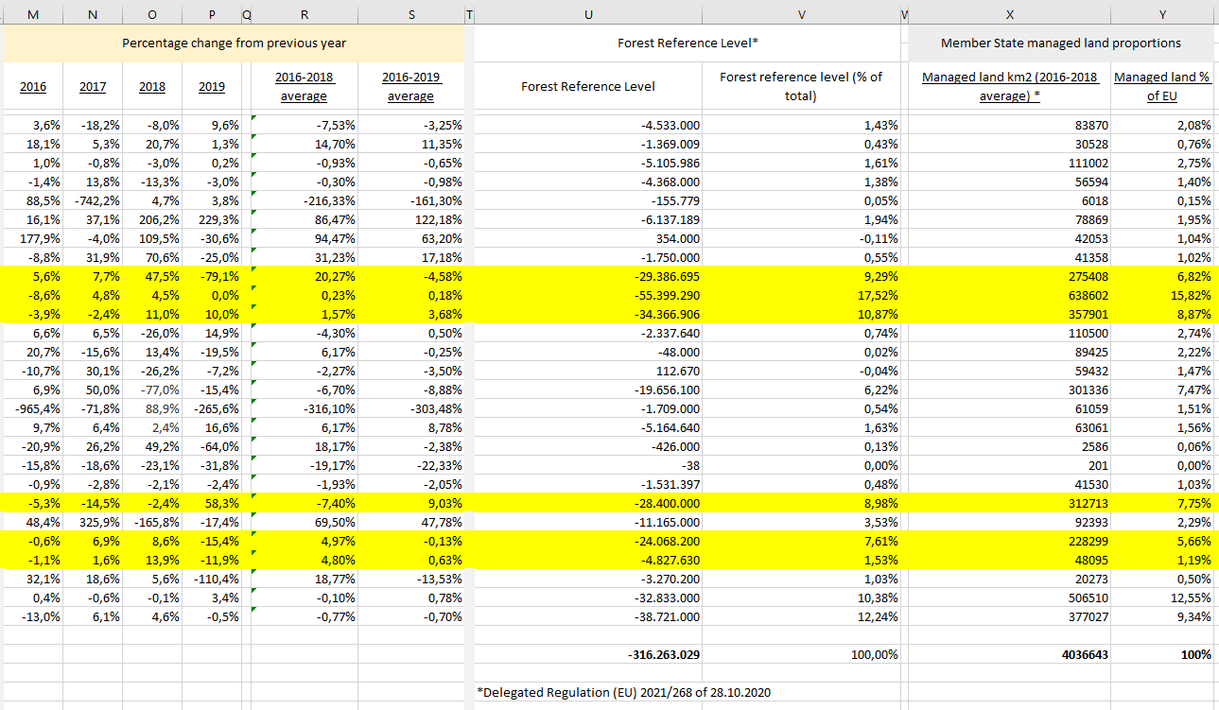

Slide 3
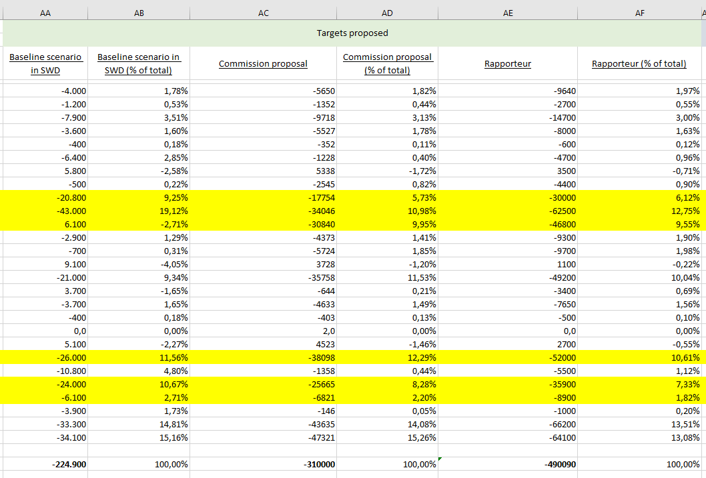

Slide 4
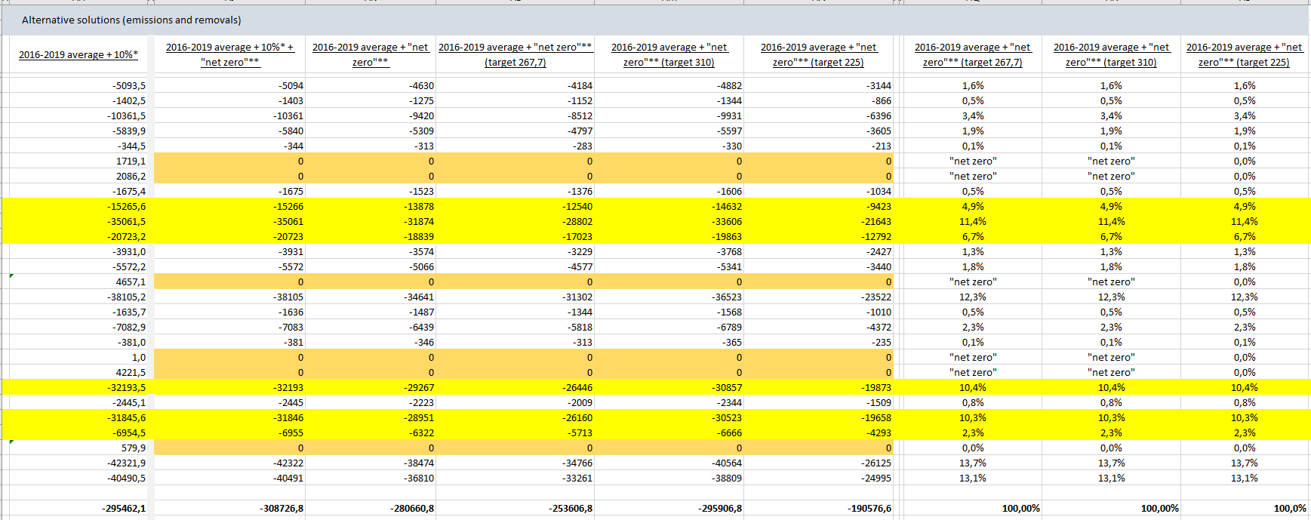

Slide 5
Other factors which may need to be included into formula:
LULUCF sector accounts for x% of national GDP
LULUCF sector accounts for x% of employment
Managed forest area
Trends since 1990
Number of consequent years making progress
Peak achievement since 1990
Other options not explored yet:
Different requirements for Member States above certain km2 of forests
Different „weights” of the currently listed and abovementioned factors in the equation for the 225 Mt. CO2 eq. part, different for the parts above it

Slide 6
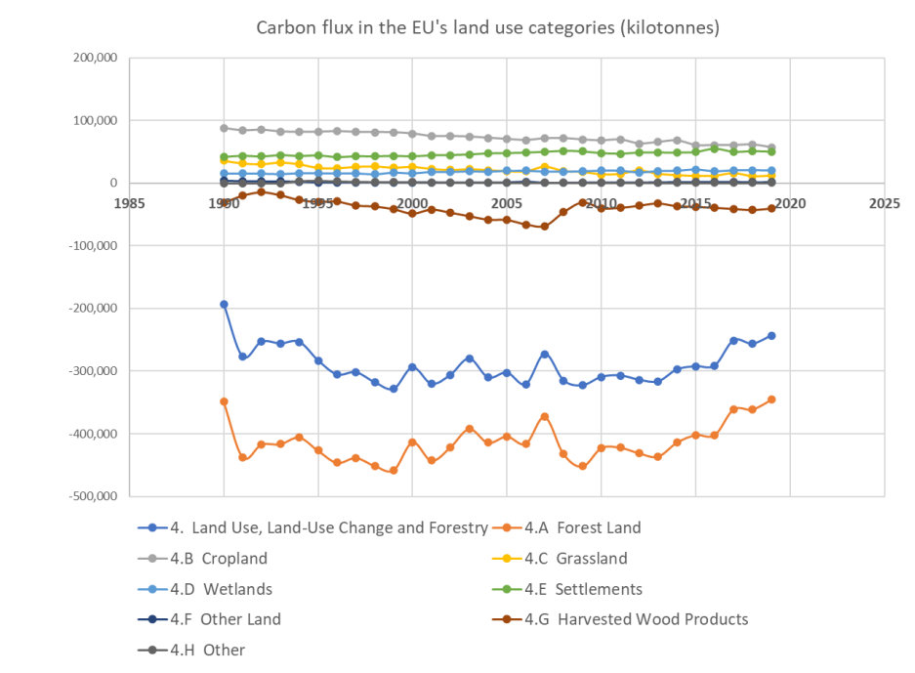
Source: PFPI

Slide 7
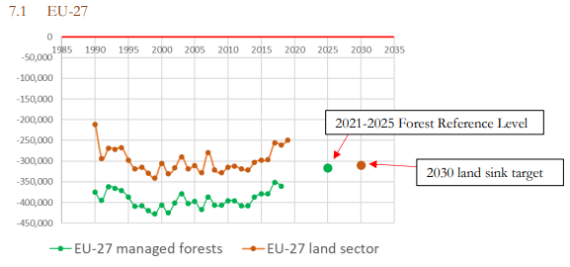
Trends since 1990 are important
Source: PFPI

Slide 8
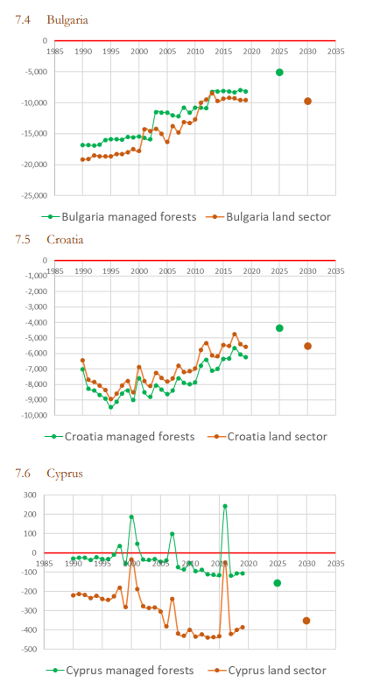
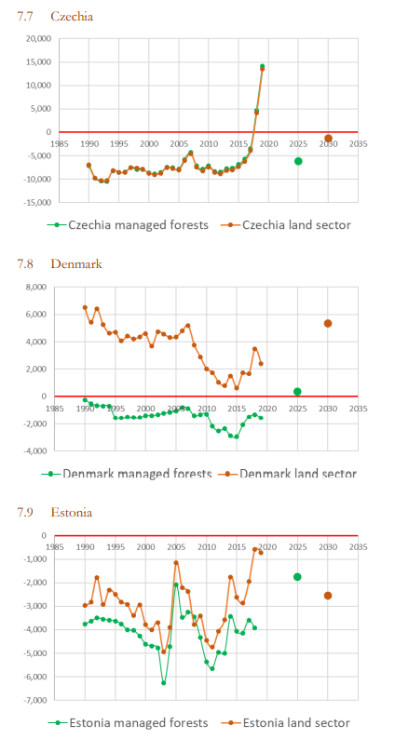
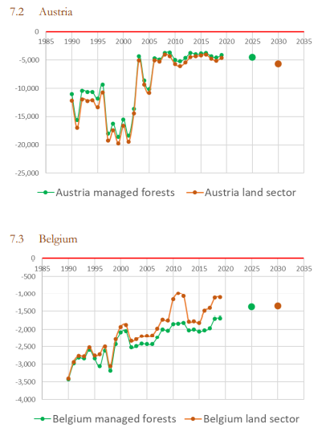
Source: PFPI

Slide 9
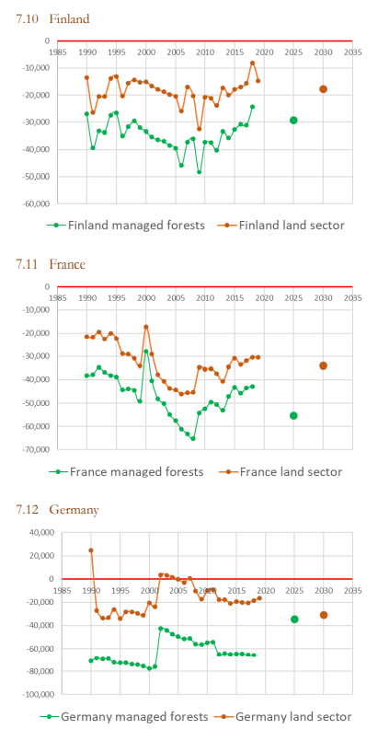
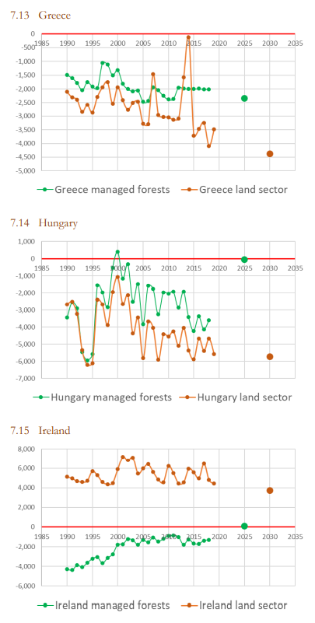
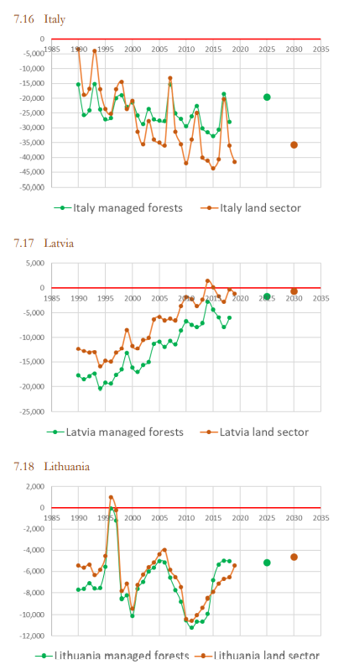
Source: PFPI

Slide 10
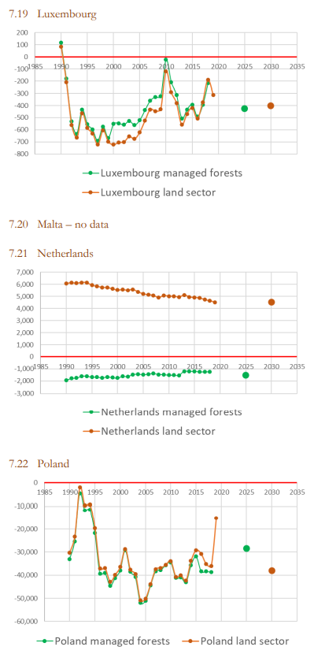
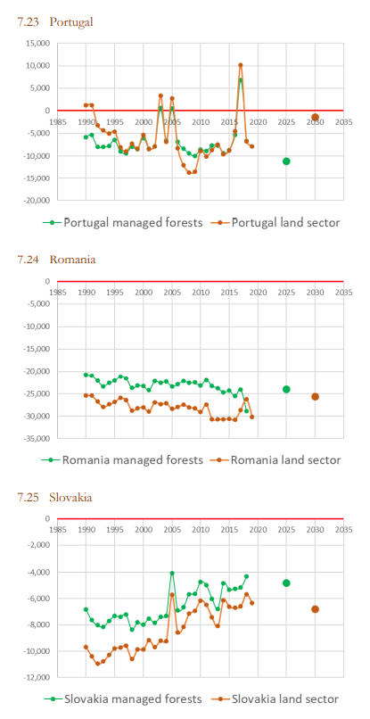
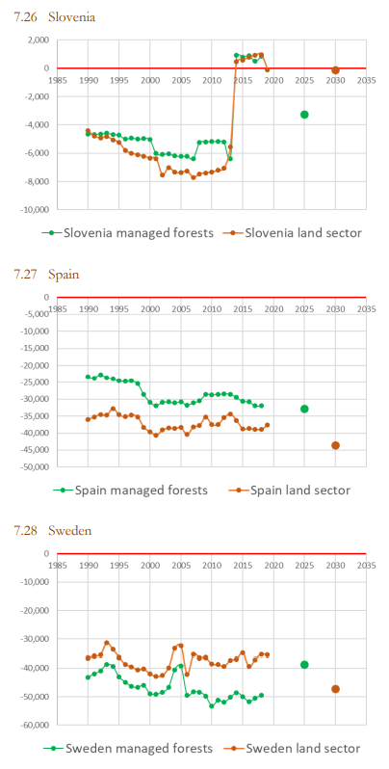
Source: PFPI

Slide 11
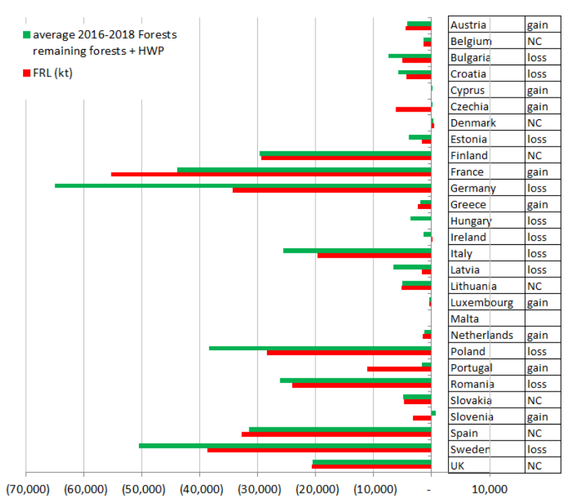
Source: PFPI

